Slide 1
Introduction to Compiler Phases

Slide 2
Translator
Programs written in high-level languages need to be translated into low-level (machine code) for processing and execution by the CPU. This is done by a translator program.
There are two types of translator program:
Compilers
Interpreters

Slide 3
Why Use a compiler?
Compiler is a program which takes one language as input and translate it into an equivalent another language.
Compiler is divided into two parts: Analysis and Synthesis
This is
a program
10000010010110100100101……
<number>
Notes:
<number>

Slide 4
Compiler
A compiler is a large program that can read a program in one language the source language - and translate it into an equivalent program in another language - the target language;
An important role of the compiler is to report any errors in the source program that it detects during the translation process
If the target program is an executable machine-language program, it can then be called by the user to process inputs and produce outputs.
Input
Source
Program
Compiler
Target
Program
Error messages
Output
<number>
Notes:
<number>

Slide 5
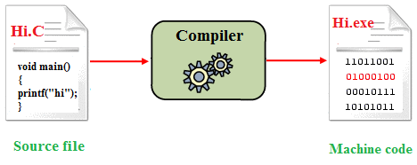
Example
<number>

Slide 6
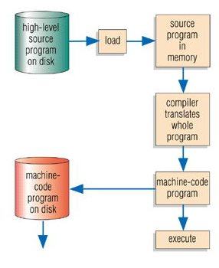
Compilers
A Compiler program translates the whole program into a machine code version that can be run without the compiler being present.
Advantage: program runs fast as already in machine code, translator program only needed at the time of compiling
Disadvantage: slow to compile as whole program translated
<number>

Slide 7
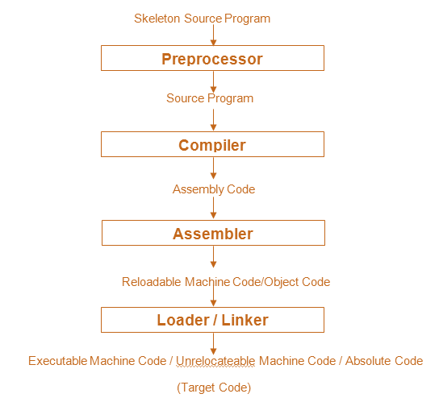
Context of a Compiler
The programs which assist the compiler to convert a skeletal source code into executable form make the context of a compiler and is as follows:
Preprocessor:
The preprocessor scans the source code and includes the header files which contain relevant information for various functions.
Compiler:
The compiler passes the source code through various phases and generates the target assembly code.
<number>

Slide 8
Phases Of Compiler

Slide 9
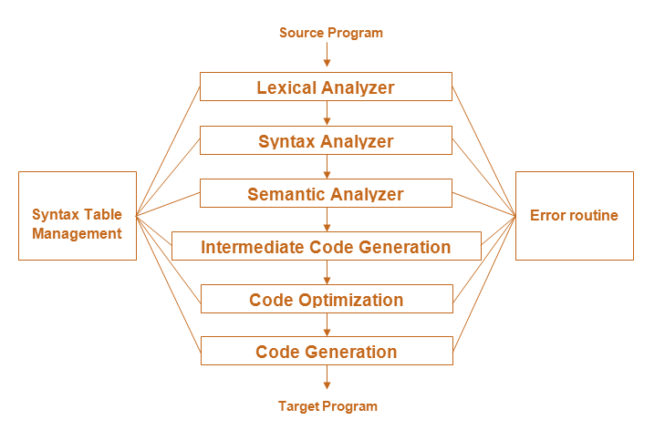
<number>

Slide 10
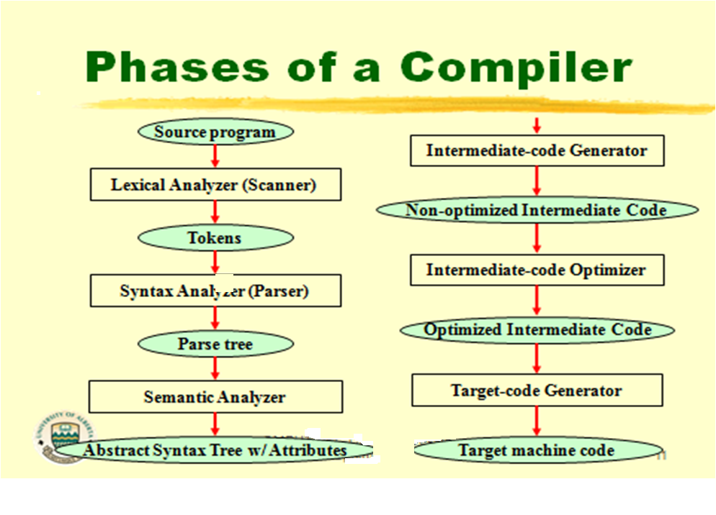
<number>
Notes:
A compiler operates in phases. A phase is a logically interrelated operation that takes source program in one representation and produces output in another representation. The phases of a compiler are shown in below
There are two phases of compilation.
Analysis (Machine Independent/Language Dependent)
Synthesis(Machine Dependent/Language independent)
Compilation process is partitioned into no-of-sub processes called ‘phases’.
<number>

Slide 11
Phases of Compilers
Analysis Phase:
Breaks the source program into constituent pieces and creates intermediate representation. The analysis part can be divided along the following phases:
The specification consists of three components:
Lexical rules which govern the formation of valid lexical units in the source language.
Syntax rules which govern the formation of valid statements in the source language.
Semantic rules which associate meaning with valid statements of the language.
Notes:
Analysis Phase:
Lexical Analysis- The program is considered as a unique sequence of characters. The Lexical Analyzer reads the program from left-to-right and sequence of characters is grouped into tokens–lexical units with a collective meaning.
Syntax Analysis- The Syntactic Analysis is also called Parsing. Tokens are grouped into grammatical phrases represented by a Parse Tree, which gives a hierarchical structure to the source program.
Semantic Analysis- The Semantic Analysis phase checks the program for semantic errors (Type Checking) and gathers type information for the successive phases. Type Checking check types of operands; No real number as index for array; etc.
Synthesis Phase:
Intermediate Code Generator- An intermediate code is generated as a program for an abstract machine. The intermediate code should be easy to translate into the target program.
Code Optimizer- This phase attempts to improve the intermediate code so that faster-running machine code can be obtained. Different compilers adopt different optimization techniques.
Code Generator- This phase generates the target code consisting of assembly code.
Here
Memory locations are selected for each variable;
Instructions are translated into a sequence of assembly instructions;
Variables and intermediate results are assigned to memory registers.
<number>

Slide 12
Phases of Compilers
Consider the following example:
percent_profit = (profit * 100) / cost_price
Lexical units identifies =, * and / operators, 100 as constant, and the remaining strings as identifiers.
Syntax analysis identifies the statement as an assignment statement with percent_profit as the left hand side and (profit * 100) / cost_price as the expression on the right hand side.
Semantic analysis determines the meaning of the statement to be the assignment of profit * 100 / cost_price to percent_profit.

Slide 13
Phases of Compilers
Language Processor
Analysis of source statements can not be immediately followed by synthesis of equivalent target statements due to following reasons:
Forward References
Issues concerning memory requirements and organization of a LP
Source Program
Analysis Phase
Synthesis Phase
Target Program
Errors
Errors

Slide 14
Phases of Compilers
Synthesis Phase
The synthesis phase is concerned with the construction of target language statements which have the same meaning as a source statement.
It performs two main activities:
Creation of data structures in the target program (memory allocation)
Generation of target code (code generation)

Slide 15
Phase-1: Lexical Analysis
Lexical analyzer reads the stream of characters making up the source program and groups the characters into meaningful sequences called lexeme
For each lexeme, the lexical analyzer produces a token of the form that it passes on to the subsequent phase, syntax analysis
(token-name, attribute-value)
Token-name: an abstract symbol is used during syntax analysis.
attribute-value: points to an entry in the symbol table for this token
<number>

Slide 16
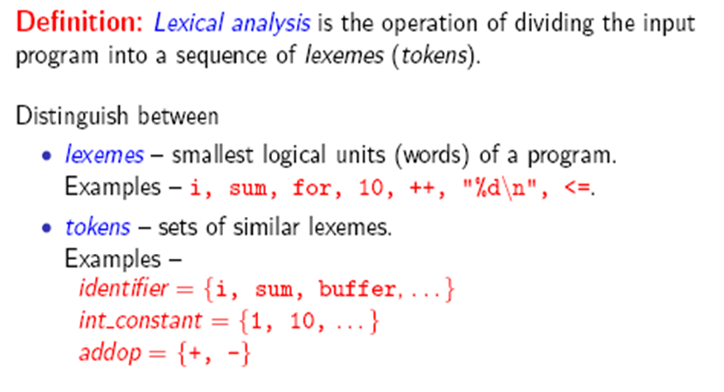
Phase-1: Lexical Analysis
<number>

Slide 17
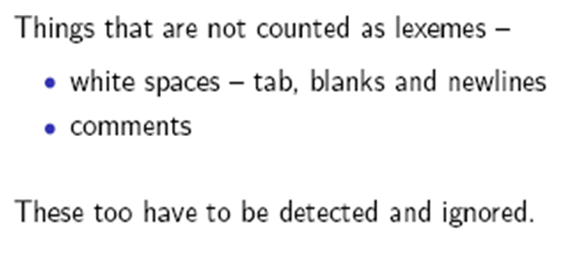
Phase-1: Lexical Analysis
<number>

Slide 18
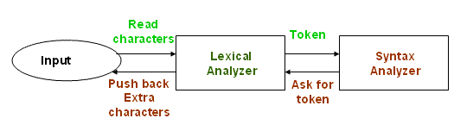
Role of the Lexical Analyzer
<number>

Slide 19
Tasks of Lexical Analyzer
Reads source text and detects the token
Stripe out comments, white spaces, tab, newline characters.
Correlates error messages from compilers to source program
Approaches to implementation
. Use assembly language- Most efficient but most difficult to implement
. Use high level languages like C- Efficient but difficult to implement
. Use tools like lex, flex- Easy to implement but not as efficient as the first
two cases
<number>

Slide 20
Example:
newval := oldval + 12
Tokens:
newval Identifier
= Assignment operator
oldval Identifier
+ Add operator
12 Number (Constant)
Lexical analyzer truncates white spaces and also removes errors.
<number>

Slide 21
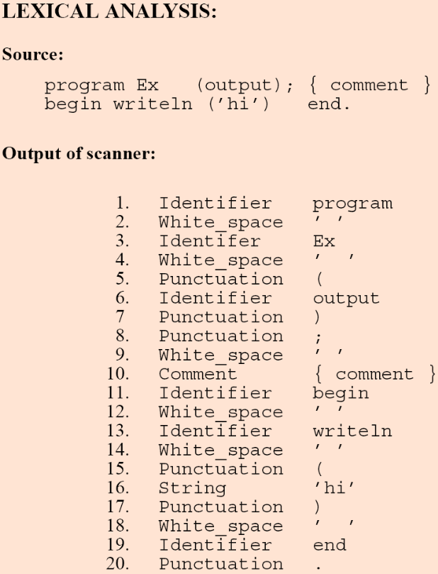
<number>

Slide 22
Phase-2: Syntax Analysis
Also called Parsing or Tokenizing.
The parser uses the first components of the tokens produced by the lexical analyzer to create a tree-like intermediate representation that depicts the grammatical structure of the token stream.
A typical representation is a syntax tree in which each interior node represents an operation and the children of the node represent the arguments of the operation
<number>

Slide 23
Syntax Analyzer
The syntax of a language is specified by a context free grammar (CFG).
The rules in a CFG are mostly recursive.
A syntax analyzer checks whether a given program satisfies the rules implied by a CFG or not.
If it satisfies, the syntax analyzer creates a parse tree for the given program.
Ex: We use BNF (Backus Naur Form) to specify a CFG
assgstmt -> identifier := expression
expression -> identifier
expression -> number
expression -> expression + expression
Compiler Design 40306
<number>

Slide 24
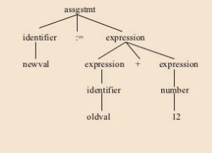
Example:
<number>

Slide 25
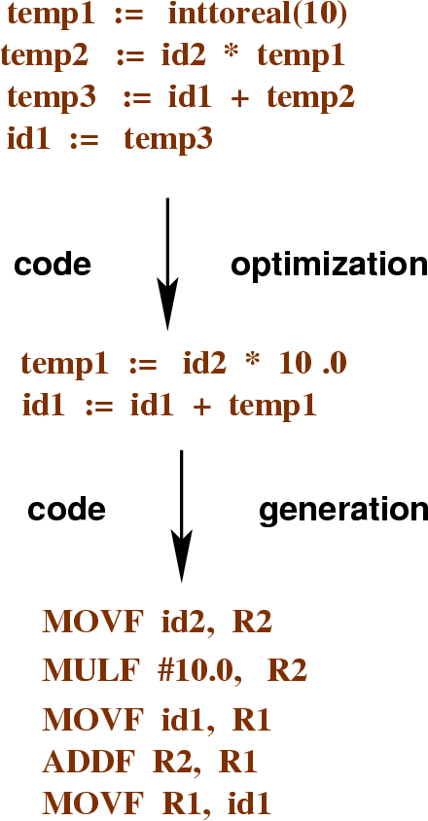
The Analysis-Synthesis Model

Slide 26
Phase-3: Semantic Analysis
The semantic analyzer uses the syntax tree and the information in the symbol table to check the source program for semantic consistency with the language definition.
Gathers type information and saves it in either the syntax tree or the symbol table, for subsequent use during intermediate-code generation.
An important part of semantic analysis is type checking, where the compiler checks that each operator has matching operands.
For example, many programming language definitions require an array index to be an integer; the compiler must report an error if a floating-point number is used to index an array.
Example: newval := oldval+12
The type of the identifier newval must match with the type of expression (oldval+12).
<number>
Notes:
<number>

Slide 27
Example:
Semantic analysis
Syntactically correct, but semantically incorrect example:
sum = a + b;
int a; double sum; data type mismatch char b;
Semantic records
a integer
sum double
b char
<number>

Slide 28
Example:
newval := oldval + fact * 1
Id1 := Id2 + Id3 * 1
Temp1 = int to real (1)
Temp2 = Id3 * Temp1
Temp3 = Id2 + Temp2
Id1 = Temp3
<number>

Slide 29
Phase-4: Intermediate Code Generation
After syntax and semantic analysis of the source program, many compilers generate an explicit low-level or machine-like intermediate representation (a program for an abstract machine). This intermediate representation should have two important properties:
it should be easy to produce and
it should be easy to translate into the target machine.
The considered intermediate form called three-address code, which consists of a sequence of assembly-like instructions with three operands per instruction. Each operand can act like a register.
This phase bridges the analysis and synthesis phases of translation.
<number>

Slide 30
Example:
newval := oldval + fact * 1
Id1 := Id2 + Id3 * 1
Temp1 = into real (1)
Temp2 = Id3 * Temp1
Temp3 = Id2 + Temp2
Id1 = Temp3
<number>

Slide 31
Phase-5: Code Optimization
The compiler looks at large segments of the program to decide how to improve performance
The machine-independent code-optimization phase attempts to improve the intermediate code so that better target code will result.
Usually better means:
faster, shorter code, or target code that consumes less power.
There are simple optimizations that significantly improve the running time of the target program without slowing down compilation too much.
Optimization cannot make an inefficient algorithm efficient - “only makes an efficient algorithm more efficient”
<number>

Slide 32
Example:
The above intermediate code will be optimized as:
Temp1 = Id3 * 1
Id1 = Id2 + Temp1
<number>

Slide 33
Phase-6: Code Generation
The last phase of translation is code generation.
Takes as input an intermediate representation of the source program and maps it into the target language
If the target language is machine, code, registers or memory locations are selected for each of the variables used by the program.
Then, the intermediate instructions are translated into sequences of machine instructions that perform the same task.
A crucial aspect of code generation is the judicious assignment of registers to hold variables.
<number>

Slide 34
Example:
Id1 := Id2 + Id3 * 1
MOV R1,Id3
MUL R1,#1
MOV R2,Id2
ADD R1,R2
MOV Id1,R1
<number>

Slide 35
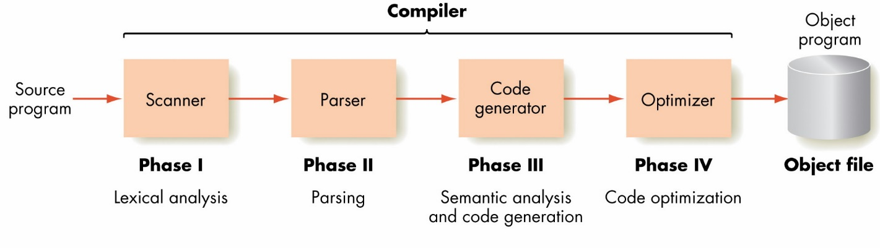
<number>

Slide 36
Symbol-Table Management
The symbol table is a data structure containing a record for each variable name, with fields for the attributes of the name.
The data structure should be designed to allow the compiler to find the record for each name quickly and to store or retrieve data from that record quickly
These attributes may provide information about the storage allocated for a name, its type, its scope (where in the program its value may be used), and in the case of procedure names, such things as the number and types of its arguments, the method of passing each argument (for example, by value or by reference), and the type returned.
new Val | Id1 & attribute
old Val | Id2 & attribute
fact | Id3 &attribute
<number>

Slide 37
Error Handling Routine:
One of the most important functions of a compiler is the detection and reporting of errors in the source program. The error message should allow the programmer to determine exactly where the errors have occurred. Errors may occur in all or the phases of a compiler.
Whenever a phase of the compiler discovers an error, it must report the error to the error handler, which issues an appropriate diagnostic message. Both of the table-management and error-Handling routines interact with all phases of the compiler.
<number>

Slide 38
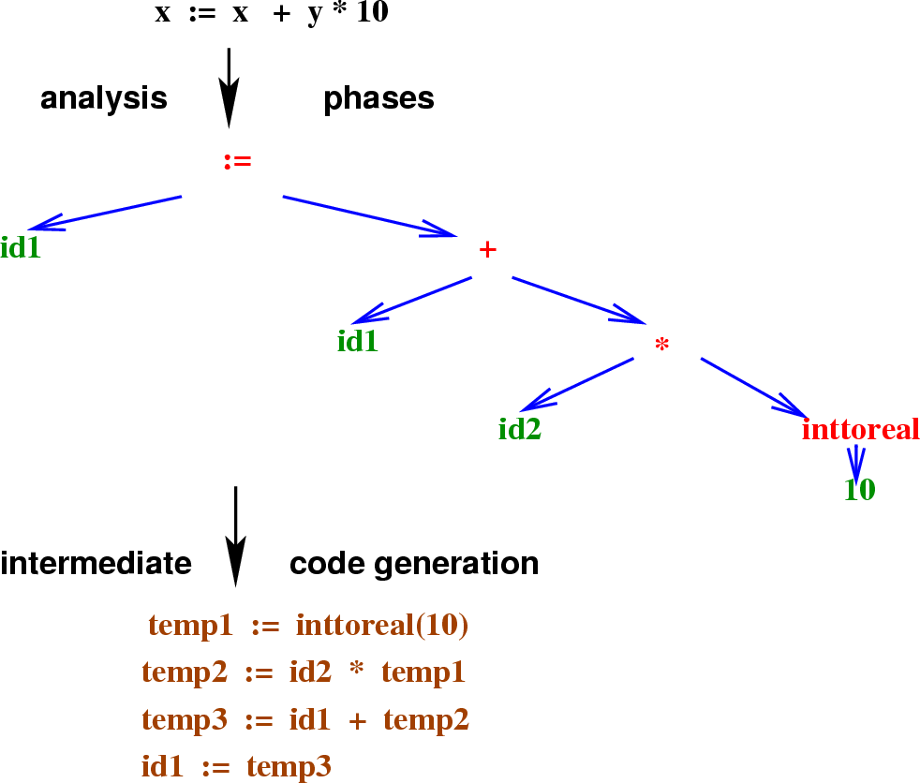
The Analysis-Synthesis Model

Slide 39
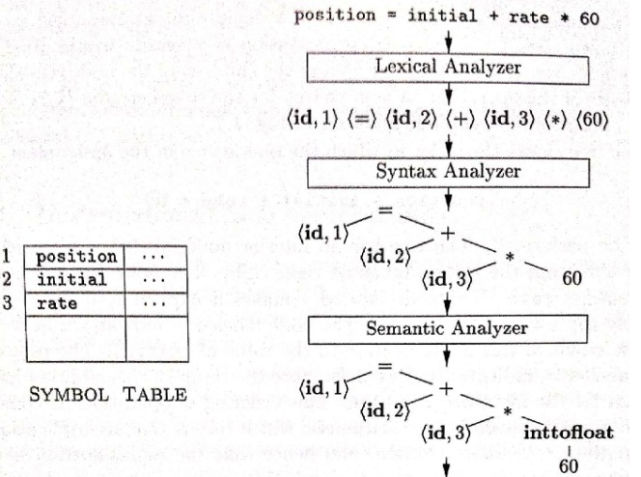
Example

Slide 40
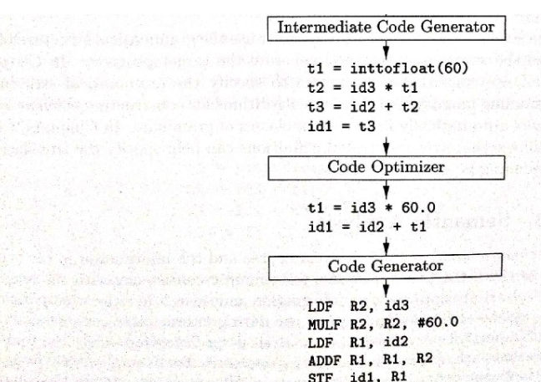
Example

Slide 41
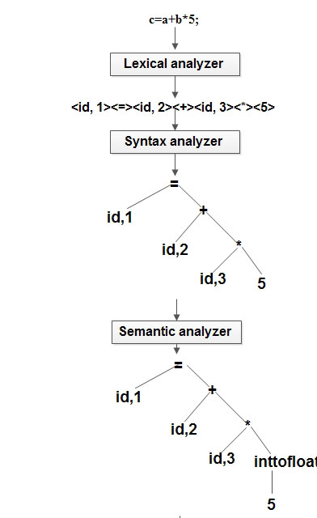
Example
(c=a+b*5)

Slide 42
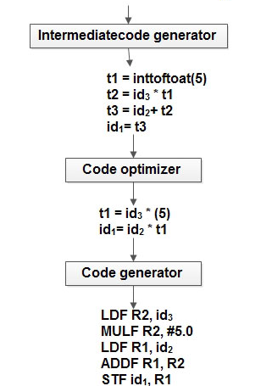
Example
(c=a+b*5)

Slide 43

Types of Compiler
Native Compiler
Cross Compiler
Compilers-Compiler
Transpiler

Slide 44
Cross Compiler
A compiler that runs on one computer platform and produces code for another is called as
“Cross compiler”.
A compiler produces a series of files called as object files.

Slide 45
COMPLIERS vs. CROSS COMPLIERS
Compiler
Cross Compiler
Uses OS as
Platform
Uses OS as
Platform
Edit the program
Compilation
Edit the program
Compilation
Running /
Execution
4. Output
Uses 2nd platform
ie hardware
Execution and output

Slide 46
Compiler-Compiler
It is a Compiler Generator
It Generates the Compiler for a Programming Language defined by attribute grammar.
Language to compile itself is the essence of bootstrapping.
Notes:
Bootstrapping may arise the question, “How was the First compiler compiled?” which sounds like “what came first, chicken or Egg?”
<number>

Slide 47
Uses of cross compiler
Embedded computers where a device has extremely limited resources.
Compiling for multiple machines. For example, a company may wish to support several different versions of an operating system or to support several different operating systems.
Notes:
Embedded computers where a device has extremely limited resources. For example, a microwave oven will have an extremely small computer to read its touchpad and door sensor, provide output to a digital display and speaker, and to control the machinery for cooking food. This computer will not be powerful enough to run a compiler, a file system, or a development environment. Since debugging and testing may also require more resources than are available on an embedded system, cross-compilation can be less involved and less prone to errors than native compilation.
Compiling for multiple machines. For example, a company may wish to support several different versions of an operating system or to support several different operating systems. By using a cross compiler, a single build environment can be set up to compile for each of these targets.
<number>

Slide 48
Transpiler
A source-to-source Compiler, transcompiler or transpiler is a type of compiler that takes the source code of a program written in one programming language as its input and produces the equivalent source code in another programming language.
For example, a source-to-source compiler may perform a translation of a program from Pascal to C

Slide 49
Interpreter
An interpreter is another common kind of language processor. Instead of producing a target program as a translation, an interpreter appears to directly execute the operations specified in the source program or inputs supplied by the user
The machine-language target program produced by a compiler is usually much faster than an interpreter at mapping inputs to outputs . An interpreter, however, can usually give better error diagnostics than a compiler, because it executes the source program statement by statement.
Source
Program
Interpreter
Output
Input
Error messages
<number>
Notes:
<number>

Slide 50
 | Compiler | Interpreter
Scanning | Compiler scans the entire program first and then translates into machine code. | Interpreter scans and translates the program line by line to equivalent machine code.
Error Report | Compiler gives you list of all errors after compilation of whole program. | Interpreter stops the translation at the error generation and will continue when error get solved.
Machine code | Compiler converts the entire program to the machine code when all the errors are removed, executiontakes place. | Each time the program is executed; every line is check for error and then converted into equivalent machine code.
Debugging | Compiler is slow for debugging. | Interpreter is good for fast debugging.
Execution Time | Compiler takes less execution time. | Interpreter takes more execution time.
Speed | Compiler is faster. | Interpreter is slower in compare to compiler.
After Modification | If you make any modification in program you have to recompile entire program i.e. scan the whole program every time after modification. | If you make any modification and if that line has not been scanned then no need to recompile entire program.

Slide 51
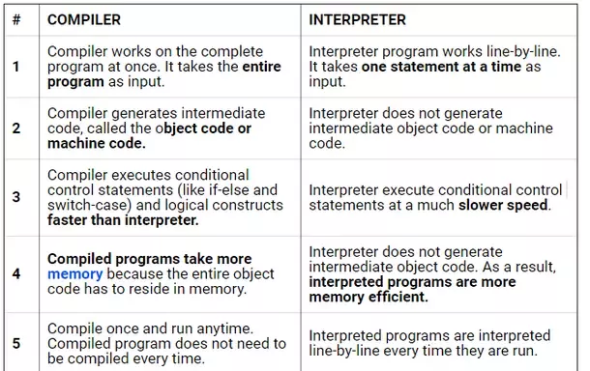

Slide 52
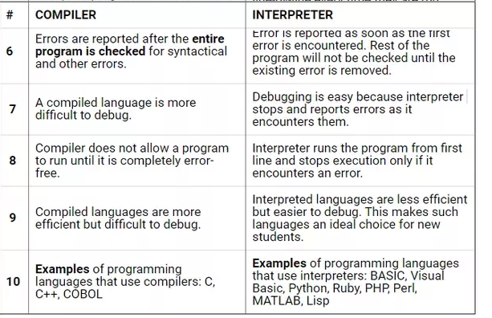

Slide 53
Working Process of Compilers Vs Interpreter
Compilation Process:
Interpretive Process:
Data
Source
program
Object
program
Results
Compiler
Executing
Computer
Compile time
Run time
Data
Source
program
Interpreter
Result
<number>
Notes:
<number>

Slide 54
Summary
Compiler front-end: lexical analysis, syntax analysis, semantic analysis
– Tasks: understanding the source code, making sure the source code is written correctly
• Compiler back-end: Intermediate code generation/improvement, and Machine code generation/improvement
– Tasks: translating the program to a semantically the same program (in a different language).

Slide 55
THANK YOU

